Slide 1
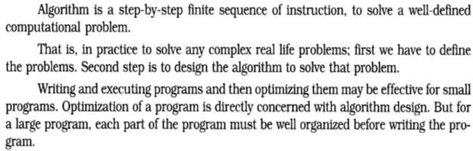
Lec.1
Data structure
Data structure is the structural representation of logical relationships between elements of data. In other words a data structure is a way of organizing data items by considering its relationship to each other.
Data structure mainly specifies the structured organization of data, by providing accessing methods with correct degree of associativity. Data structure affects the design of both the structural and functional aspects of a program.
Program = Algorithm + Data Structure
Data structures are the building blocks of a program; here the selection of a particular data structure will help the programmer to design more efficient programs as the complexity and volume of the problems solved by the computer is steadily increasing day by day. The programmers have to strive hard to solve these problems. If the problem is analyzed and divided into sub problems, the task
will be much easier i.e., divide, conquer and combine.
A complex problem usually cannot be divided and programmed by set of modules unless its solution is structured or organized. This is because when we divide the big problems into sub problems, these sub problems will be programmed by different programmers or group of programmers. But all the programmers should follow a standard structural method so as to make easy and efficient integration of these modules. Such type of hierarchical structuring of program modules and sub modules should not only reduce the complexity and control the flow of program statements but also promote the proper structuring of information. By choosing a particular structure (or data structure) for the data items, certain data items become friends while others loses its relations.
Algorithm
Representation of algorithm can written By:-
In natural language (English) / pseudo-code / diagrams (Flow chart) / etc.
Pseudo- code:-
A mixture of natural language and high – level programming concepts that describes the main ideas behind a generic implementation of a data structure or algorithm. Pseudo- code is more structured than usual language but less formal than a programming language.
E.g.:- Algorithm arrayMax ( A, n )
input: An array A sorting n integers output: The Maximum element in A

Slide 2
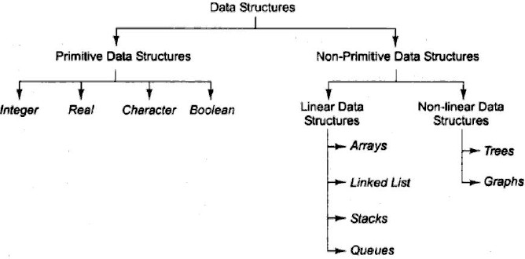
Lec.1
currentMax ← A[0] for i ← 1 to n-1 do
if currentMax < A[i] then currentMax ← A[i] return currentMax
Ex: An algorithm to find sum n numbers between any given range numbers
Start
Read N
Sum =0
For I= 1 to N
4.1 sum = sum + I
4.1 next I 5- print Sum
6- End
What Makes a Good Algorithm?
Suppose you have two possible algorithms or data structures that basically do the same thing; which is better?
Faster
Less space
Easier to code
Easier to maintain
Fig.1 Classifications of data structures
Classification of data structure
Data structures are broadly divided into two:
1. Primitive data structures: These are the basic data structures and are directly operated upon by the machine instructions, which is in a primitive level. They are integers, floating point numbers,
characters, string constants, pointers etc. These primitive data structures are the basis for the discussion of more sophisticated (non-primitive) data structures.

Slide 3
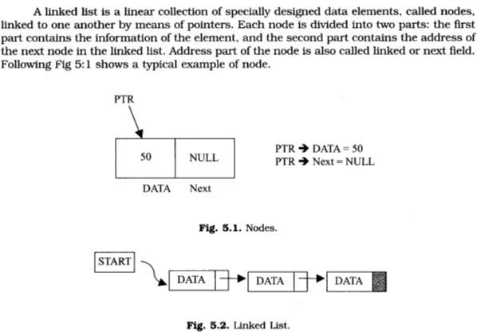
Lec.1
2. Non-primitive data structures: It is a more sophisticated data structure emphasizing on structuring of a group of homogeneous (same type) or heterogeneous (different type) data items. Array, list, files, linked list, trees and graphs fall in this category.
How to choose the suitable data structure:-
For each set of data, there are different methods to organize these data in a particular data structure. To choose the suitable data structure, we must use the following criteria:-
1- Data size and the required memory. 2- The dynamic nature of the data.
The required time to obtain any data element from the data structure.
The programming approach and the algorithm that will be used to manipulate these data.
Assignment -1-
Write an algorithm for the following
a- count even& odd numbers in given range
LINKED LIST DATA STRUCTURE
Fig.5.2.shows a schematic diagram of a linked list with 3 nodes. Each node is pictured with two parts. The left part of each node contains the data items and the right part represents the address of the next node; there is an arrow drawn from it to the next node. The next pointer of the last node contains a special value, called the NULL pointer, which does not point to any address of the node. That is NULL pointer indicates the end of the linked list. START pointer will hold the address of the 1st node in the list START = NULL if there is no list (i.e.; NULL list or empty list).

Slide 4
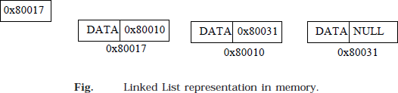
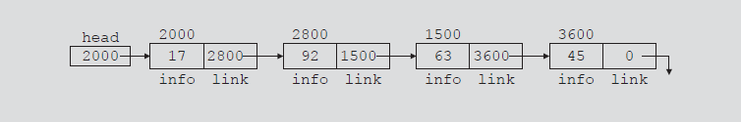
Lec.1
Explanation:
Because each node of a linked list has two components, we need to declare each node as a class or struct. The data type of each node depends on the specific application—that is, what kind of data is being processed. However, the link component of each node is a pointer. The data type of this pointer variable is the node type itself. For the previous linked list, the definition of the node is as follows. (Suppose that the data type is int.)
struct nodename
{
int info; nodename *link;
};
The variable declaration is as follows: nodename *head;
Linked List: Some Properties
To better understand the concept of a linked list and a node, some important properties of linked lists are described next.
Consider the linked list in Figure 5-4.
FIGURE 5-4 Linked list with four nodes
This linked list has four nodes. The address of the first node is stored in the pointer head.
Each node has two components: info, to store the info, and link, to store the address of the next node. For simplicity, we assume that info is of type int.
Suppose that the first node is at location 2000, the second node is at location 2800, the third node is
at location 1500, and the fourth node is at location 3600. Table Table 5-1 shows the values of head and some other nodes in the list shown in Figure 5-4.

Slide 5
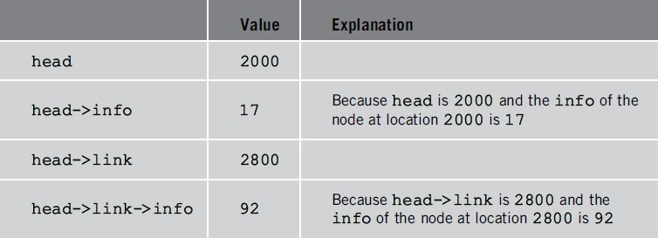
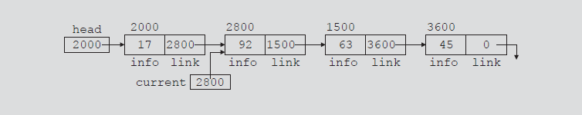
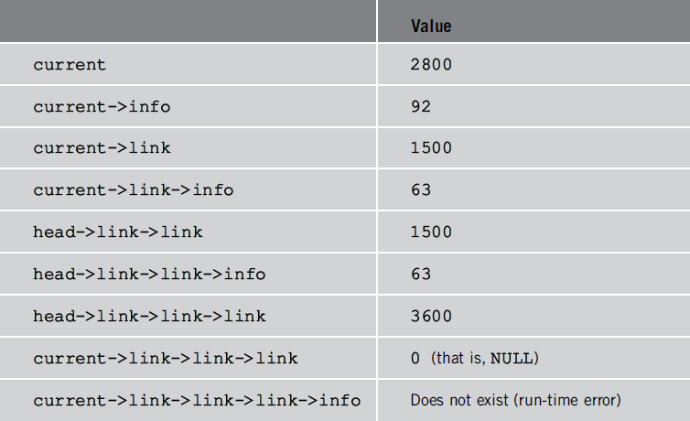
Lec.1
TABLE 5-1 Values of head and some of the nodes of the linked list in Figure 5-4
Suppose that current is a pointer of the same type as the pointer head. Then the statement
current = head;
copies the value of head into current. Now consider the following statement: current = current->link;
This statement copies the value of current->link, which is 2800, into current.
Therefore, after this statement executes, current points to the second node in the list. (When working with linked lists, we typically use these types of statements to advance a pointer to the next node in the list.) See Figure 5-5.
FIGURE 5-5 List after the statement current = current->link; executes
Table 5-2 shows the values of current, head, and some other nodes in Figure 5-5
TABLE 5-2 Values of current, head, and some of the nodes of the linked list in Figure 5-5

Slide 6
Lec.1
TRAVERSING A LINKED LIST
The basic operations of a linked list are as follows: Search the list to determine whether a particular item is in the list, insert an item in the list, display the elements of the list, and delete an item from the list.
These operations require the list to be traversed. That is, given a pointer to the first node of the list, we must step through the nodes of the list.
Suppose that the pointer head points to the first node in the list, and the link of the last node is NULL. We cannot use the pointer head to traverse the list because if we use the head to traverse the list, we would lose the nodes of the list. This problem occurs because the links are in only one direction. The
pointer head contains the address of the first node, the first node contains the address of the second node, the second node contains the address of the third node, and so on. If we move head to the second node, the first node is lost (unless we save a pointer to this node). If we keep advancing head to the
next node, we will lose all the nodes of the list (unless we save a pointer to each node before advancing
head, which is impractical because it would require additional computer time and memory space to maintain the list). Therefore, we always want head to point to the first node. It now follows that we must traverse the list using another pointer of the same type. Suppose that current is a pointer of the same type as head. The following code traverses the list:
current = head;
while (current != NULL)
{
//Process current current = current->link;
}
For example, suppose that head points to a linked list of numbers. The following code outputs the data stored in each node:
current = head;
while (current != NULL)
{
cout << current->info << " "; current = current->link;
}
LINKED LIST ALGORITHMS
This section discusses the algorithms of linked list data structures. Consider the following definition of a node. (For simplicity, we assume that the info type is int.)
struct nodename
{
int info; nodename *link;
};
We will use the following variable declaration: nodename *head, *p, *q, *newNode;

Slide 7
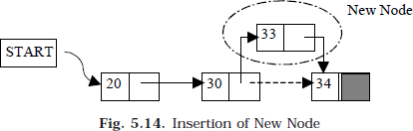
Lec.1
ALGORITHM FOR INSERTING A NODE
Suppose START is the first position in linked list. Let DATA be the element to be inserted in the new node. POS is the position where the new node is to be inserted. TEMP is a temporary pointer to hold the node address.
Insert a Node at the beginning
Input DATA to be inserted
Create a NewNode
NewNode -> DATA = DATA
If (SATRT equal to NULL)
  NewNode -> Link = NULL
Else
  NewNode -> Link = START
START = NewNode
Exit
Insert a Node at the end
Input DATA to be inserted
Create a NewNode
NewNode -> DATA = DATA
NewNode -> Next = NULL
If (SATRT equal to NULL)
  START = NewNode
Else
  TEMP = START
  While (TEMP -> Next not equal to NULL)
    TEMP = TEMP -> Next
TEMP -> Next = NewNode
Exit
Insert a Node at any specified position
Input DATA and POS to be inserted
initialize TEMP = START; and k = 0
Repeat the step 3 while( k is less than POS)

Slide 8

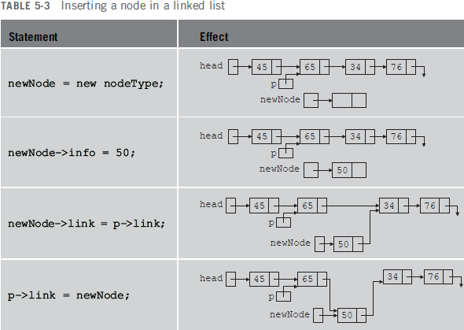
Lec.1
TEMP = TEMP -> Next
If (TEMP is equal to NULL)
  Display “Node in the list less than the position”
  Exit
k = k + 1
Create a New Node
NewNode -> DATA = DATA
NewNode -> Next = TEMP -> Next
TEMP -> Next = NewNode
Exit
Consider the linked list shown in Figure 5-6.
Suppose that p points to the node with info 65, and a new node with info 50 is to be created and inserted after p. Consider the following statements:
newNode = new nodename; newNode->info = 50; newNode->link = p->link; p->link = newNode;
//create newNode
//store 50 in the new node
Table 5-3 shows the effect of these statements.
Note that the sequence of statements to insert the node, that is, newNode->link = p->link;
p->link = newNode;

Slide 9
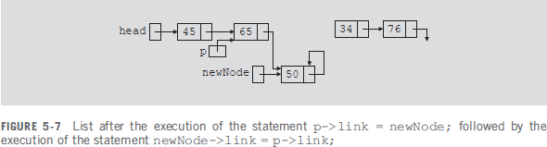

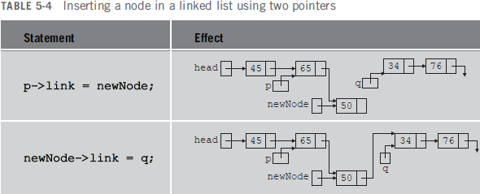
Lec.1
is very important because to insert newNode in the list we use only one pointer, p, to adjust the links of the nodes of the linked list. Suppose that we reverse the sequence of the statements and execute the statements in the following order:
p->link = newNode; newNode->link = p->link;
Figure 5-7 shows the resulting list after these statements execute.
From Figure 5-7, it is clear that newNode points back to itself and the remainder of the list is lost. Using two pointers, we can simplify the insertion code somewhat. Suppose q points to the node with info 34. (See Figure 5-8.)
The following statements insert newNode between p and q: newNode->link = q;
p->link = newNode;
The order in which these statements execute does not matter. To illustrate this, suppose that we execute the statements in the following order:
p->link = newNode; newNode->link = q;
Table 5-4 shows the effect of these statements.

Slide 10

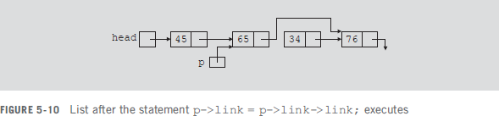
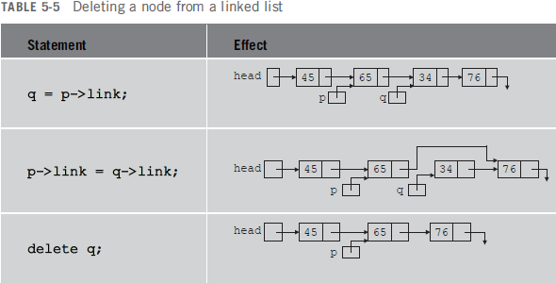

Lec.1
ALGORITHM FOR DELETING A NODE
Consider the linked list shown in Figure 5-9.
Suppose that the node with info 34 is to be deleted from the list. The following statement removes the node from the list:
p->link = p->link->link;
Figure 5-10 shows the resulting list after the preceding statement executes.
From Figure 5-10, it is clear that the node with info 34 is removed from the list.
However, the memory is still occupied by this node and this memory is inaccessible; that is, this node is dangling. To deallocate the memory, we need a pointer to this node. The following statements delete
the node from the list and deallocate the memory occupied by this node: q = p->link;
p->link = q->link; delete q;
Table 5-5 shows the effect of these statements.

Slide 11
Lec.1
Deletion of a Node
Suppose START is the first position in linked list. Let DATA be the element to be deleted. TEMP, HOLD is a temporary pointer to hold the node address.
Input the DATA to be deleted
if ((START -> DATA) is equal to DATA)
  TEMP = START
  START = START -> Next
  Set free the node TEMP, which is deleted
  Exit
HOLD = START
while ((HOLD -> Next -> Next) not equal to NULL))
  if ((HOLD -> NEXT -> DATA) equal to DATA)
    TEMP = HOLD -> Next
    HOLD -> Next = TEMP -> Next
    Set free the node TEMP, which is deleted
    Exit
  HOLD = HOLD -> Next
if ((HOLD -> next -> DATA) == DATA)
  TEMP = HOLD -> Next
  Set free the node TEMP, which is deleted
  HOLD -> Next = NULL
  Exit
Disply “DATA not found”
Exit
ALGORITHM FOR SEARCHING A NODE
Suppose START is the address of the first node in the linked list and DATA is the information to be searched. After searching, if the DATA is found, POS will contain the corresponding position in the list.
Input the DATA to be searched
Initialize TEMP = START; POS =1;
Repeat the step 4, 5 and 6 until (TEMP is equal to NULL)
If (TEMP → DATA is equal to DATA)
  Display “The data is found at POS”
  Exit
TEMP = TEMP → Next
POS = POS+1
If (TEMP is equal to NULL)
  Display “The data is not found in the list”
Exit
ALGORITHM FOR DISPLAY ALL NODES

Slide 12
Lec.1
Suppose START is the address of the first node in the linked list. Following algorithm will visit all nodes from the START node to the end.
If (START is equal to NULL)
  Display “The list is Empty”
  Exit
Initialize TEMP = START
Repeat the step 4 and 5 until (TEMP == NULL )
Display “TEMP → DATA”
TEMP = TEMP → Next
Exit
BUILDING A LINKED LIST
Now that we know how to insert a node in a linked list, let us see how to build a linked list. First, we consider a linked list in general. If the data we read is unsorted, the linked list will be unsorted. Such a list can be built in two ways: forward and backward. In the forward manner, a new node is always inserted at the end of the linked list. In the backward manner, a new node is always inserted at the beginning of the list. We will consider both cases.
BUILDING A LINKED LIST FORWARD
Suppose that the nodes are in the usual info-link form and info is of type int. Let us assume that we process the following data: 2 15 8 24 34
We need three pointers to build the list: one to point to the first node in the list, which cannot be
moved, one to point to the last node in the list, and one to create the newnode. Consider the following variable declaration:
nodename *first, *last, *newNode; int num;
Suppose that first points to the first node in the list. Initially, the list is empty, so both first and last are NULL. Thus, we must have the statements
first = NULL; last = NULL;
to initialize first and last to NULL. Next, consider the following statements:
cin >> num;
newNode = new nodename; the
//read and store a number in num
//allocate memory of type nodename and store the address of
newNode->info = num;
newNode->link = NULL; 5 if (first == NULL)
//allocated memory in newNode
//copy the value of num into the info field of newNode
//initialize the link field of newNode to NULL
//if first is NULL, the list is empty;
//make first and last point to newNode
5a 5b
{
first = newNode; last = newNode;
}

Slide 13




Lec.1
6 else
{
6a 6b
//list is not empty
last->link = newNode; last = newNode;
//insert newNode at the end of the list
//set last so that it points to the
//actual last node in the list
}
Let us now execute these statements. Initially, both first and last are NULL. Therefore, we have the list as shown in Figure 5-11.
After statement 1 executes, num is 2. Statement 2 creates a node and stores the address of that node in newNode. Statement 3 stores 2 in the info field of newNode, and statement 4 stores NULL in the link field of newNode. (See Figure 5-12.)
Because first is NULL, we execute statements 5a and 5b. Figure 5-13 shows the resulting list.
We now repeat statements 1 through 6b. After statement 1 executes, num is 15. Statement 2 creates a node and stores the address of this node in newNode. Statement 3 stores 15 in the info field of newNode, and statement 4 stores NULL in the link field of newNode. (See Figure 5-14.)

Slide 14

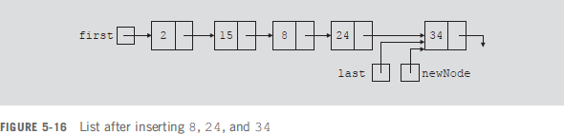
Lec.1
Because first is not NULL, we execute statements 6a and 6b. Figure 5-15 shows the resulting list.
We now repeat statements 1 through 6b three more times. Figure 5-16 shows the resulting list.
We can put the previous statements in a loop, and execute the loop until certain conditions are met, to build the linked list. We can, in fact, write a C++ function to build a linked list.
Suppose that we read a list of integers ending with -999. The following function, buildListForward, builds a linked list (in a forward manner) and returns the pointer of the built list:
nodename* buildListForward()
{
nodename *first, *newNode, *last; int num;
cout << "Enter a list of integers ending with -999." << endl; cin >> num;
first = NULL;
while (num != -999)
{
newNode = new nodename; newNode->info = num; newNode->link = NULL;
if (first == NULL)
{
first = newNode; last = newNode;
}
else
{
last->link = newNode;

Slide 15
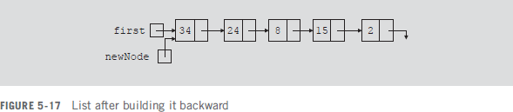
Lec.1
last = newNode;
}
cin >> num;
} //end while
return first;
} //end buildListForward
BUILDING A LINKED LIST BACKWARD
Now we consider the case of building a linked list backward. For the previously given data—2, 15, 8, 24, and 34—the linked list is as shown in Figure 5-17.
Because the new node is always inserted at the beginning of the list, we do not need to know the end of the list, so the pointer last is not needed. Also, after inserting the new node at the beginning, the new node becomes the first node in the list. Thus, we need to update the value of the pointer first to correctly point to the first node in the list. We see, then, that we need only two pointers to build the linked list: one to point to the list and one to create the new node. Because initially the list is empty, the pointer first must be initialized to NULL. The following C++ function builds the linked list backward and returns the pointer of the built list:
nodename* buildListBackward()
{
nodename *first, *newNode; int num;
cout << "Enter a list of integers ending with -999." << endl; cin >> num;
first = NULL;
while (num != -999)
{
newNode = new nodename; //create a node
newNode->info = num; //store the data in newNode newNode->link = first;
//put newNode at the beginning
//of the list
//update the head pointer of
//the list, that is, first
//read the next number
first = newNode;
}
return first;
cin >> num;
}
//end buildListBackward

